Slide 1
CSE470: Software Engineering
Repository, Client Server Architecture

Slide 2
What is a Repository
Before going into repository design pattern let's first understand what is repository:
In generic terms repository simply means a place where things are or can be stored.
This term has wide array of use in computer science for example code repository.
We are all familiar with GITHUB. it’s a code repository

Slide 3
What is a Repository Architecture
It will have multiple sub systems.
Sub-systems must exchange data. This may be done in two ways:
  Shared data is held in a central database or repository and may be accessed by all sub-systems;
  Each sub-system maintains its own database and passes data explicitly to other sub-systems.
When large amounts of data are to be shared, the repository model of sharing is most commonly used as this is an efficient data sharing mechanism.

Slide 4
Formal Definition
A Repository mediates between the domain and data mapping layers, acting like an in-memory domain object collection. Client objects construct query specifications declaratively and submit them to Repository for satisfaction. Objects can be added to and removed from the Repository, as they can from a simple collection of objects, and the mapping code encapsulated by the Repository will carry out the appropriate operations behind the scenes.

Slide 5
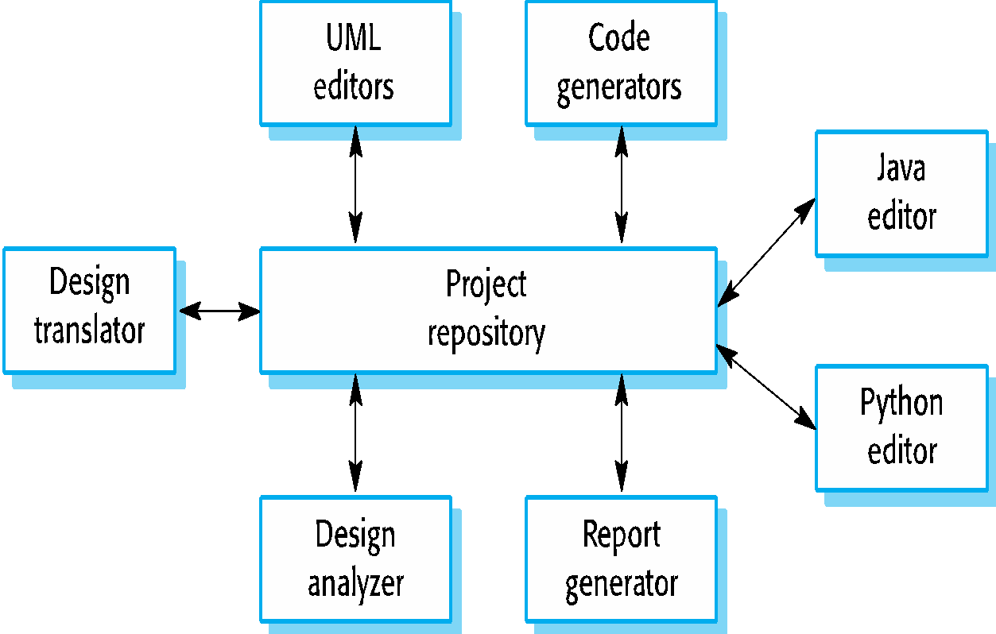
Example
Let's think you are developing an IDE like ’eclipse’.What will you have there:
editor for different language like java,c++.python
code generator, auto complete system
UML editor
Translator to compile the code etc.
So here in the IDE where the components use a repository of system design information.
Each software tool generates information which is then available for use by other tools.
And, sub-components do not communicate with each other, means they are independent.
Have a look at the figure for the example

Slide 6
When Used
You should use this pattern when you have a system in which large volumes of information are generated that has to be stored for a long time. You may also use it in data-driven systems where the inclusion of data in the repository triggers an action or tool.

Slide 7
Advantages-Disadvantages
Advantages
Components can be independent—they do not need to know of the existence of other components.
Changes made by one component can be propagated to all components.
All data can be managed consistently (e.g., backups done at the same time) as it is all in one place.
Data security is of higher importance.
Disadvantages
The repository is a single point of failure so problems in the repository affect the whole system.
May be inefficiencies in organizing all communication through the repository – latency and processing overhead.
Distributing the repository across several computers may be difficult. (Scalability issue, can be solved by synchronizing tools, but, complex and costly.)

Slide 8
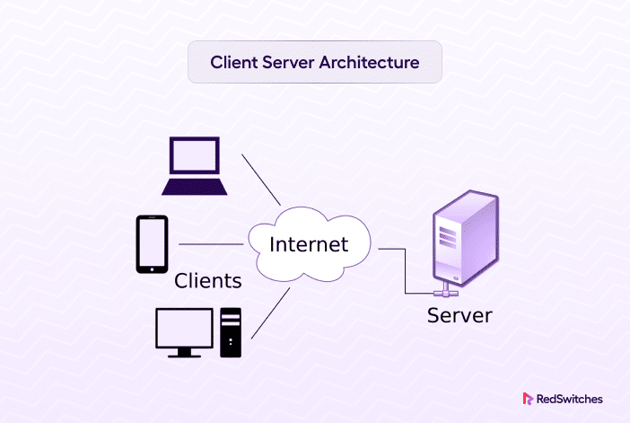
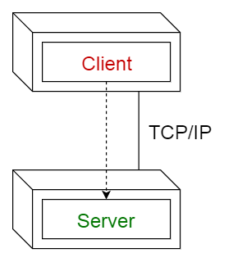
What is Client-Server Architecture
This pattern consists of two parties; a server and multiple clients.
The server component will provide services to multiple client components.
Clients request services from the server and the server provides relevant services to those clients.
Furthermore, the server continues to listen to client requests.
Set of stand-alone servers which provide specific services such as printing, data management, etc.
Set of clients which call on these services.
Network which allows clients to access servers.

Slide 9

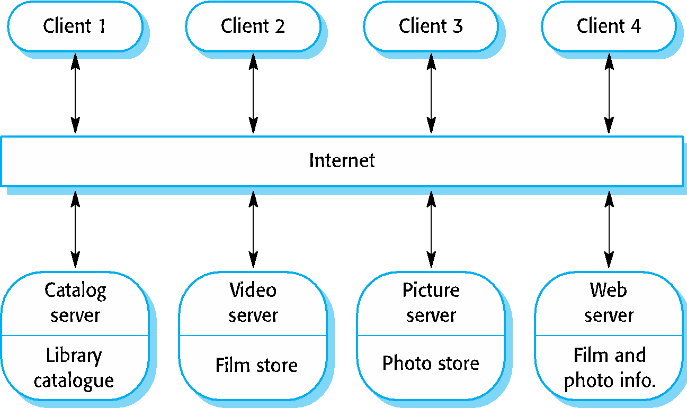
Example
Online applications such as email, document sharing and banking.
Figure is an example of a film and video/DVD library organized as a client–server system.

Slide 10
Client-Server Architecture
Student Record Request Flow
Browser → Server → Database → Response

Slide 11
User enters student ID in the browser
Step 1/6
Student lookup
2021-CSE-047
Send
Internet / HTTPS
Internal network
Server
Client
Database
BRACU API
Student
Students DB
Network log
→ REQUEST User typed "2021-CSE-047" and clicked Send

Slide 12
Browser sends HTTP request to server
Step 2/6
Internet / HTTPS
Internal network
GET /student?id=2021-CSE-047
Server
Client
Database
BRACU API
Student
Students DB
Network log
→ REQUEST GET /api/student?id=2021-CSE-047
→ REQUEST Headers: Authorization: Bearer <JWT>, Content-Type: application/json

Slide 13
Server authenticates token and routes request
Step 3/6
Internet / HTTPS
Internal network
✓
Server
Client
Database
BRACU API
Student
Students DB
1. Verify JWT token
Network log
2. Check permissions
→ REQUEST GET /api/student?id=2021-CSE-047 received
3. Route → StudentController
⚙ SERVER JWT verified — user: admin@bracu.ac.bd
⚙ SERVER Routing to StudentController.getRecord()

Slide 14
Server queries the database
Step 4/6
Internet / HTTPS
Internal network
SELECT * WHERE id='2021-CSE-047'
✓
Server
Client
Database
BRACU API
Student
Students DB
Network log
⚙ SERVER Building SQL query…
⬡ DB SELECT * FROM students WHERE student_id = '2021-CSE-047'
⬡ DB Query dispatched over internal network (not exposed to internet)

Slide 15
Database returns the student record
Step 5/6
Internet / HTTPS
Internal network
{ name, cgpa, credits, semester… }
✓
✓
Server
Client
Database
BRACU API
Student
Students DB
Result set (1 row)
name:
Rafiul Hasan
Network log
dept:
CSE
cgpa:
3.72
⬡ DB Query executed in 4ms — 1 row returned
credits:
120
⬡ DB { name: "Rafiul Hasan", cgpa: 3.72, credits: 120, semester: "8th" }

Slide 16
Server delivers HTTP 200 response to browser
Step 6/6
Internet / HTTPS
Internal network
200 OK { student record }
✓
Server
✓
Client
Database
BRACU API
Student
Students DB
Network log
⚙ SERVER Serialising JSON — filtering sensitive fields, setting cache headers
✓ RESPONSE 200 OK — Content-Type: application/json — payload: 842 bytes

Slide 17
Response rendered — student record displayed
Internet / HTTPS
RH
Rafiul Hasan
Internal network
✓
2021-CSE-047 · Computer Science & Engineering
✓
Server
✓
Client
Database
BRACU API
CGPA
CREDITS EARNED
Student
3.72 / 4.00
Students DB
120
CURRENT SEMESTER
STATUS
8th
Active
Network log
✓ RESPONSE 200 OK — Student record received and rendered in 187ms total
✓ RESPONSE Browser updated — student dashboard now showing Rafiul Hasan's record

Slide 18
Full request lifecycle
User enters student ID
Server queries the database
1
4
Browser sends HTTP request
Database returns student record
2
5
Server authenticates & routes
200 OK response to browser
3
6

Slide 19
When Used
It is used when data in a shared database has to be accessed from a range of locations. Because servers can be replicated, may also be used when the load on a system is variable and can be resolved by a load balancer.

Slide 20
Advantages
The principal advantage of this model is that servers can be distributed across a network.
Data recovery is possible.
Can be deployed to the cloud, hosted and managed by third-parties (AWS, Azure) which offloads physical infrastructure burden and easy to manage.

Slide 21
Disadvantages
Each service is a single point of failure so susceptible to denial of service (DoS) attacks or server failure.
Performance may be unpredictable because it depends on the network as well as the system.
Cost inefficient as requires maintenance cost.
May be management problems if servers are owned by different organizations.

